Slide 1

Lake Washington PCB/PBDE Study
Estimates of loading from major pathways
Curtis DeGasperi, Jenée Colton, and Richard Jack
Science Section
King County Water and Land Resources Division, Department of Natural Resources and Parks
2014 Salish Sea Ecosystem Conference
May 1, 2014

Slide 2
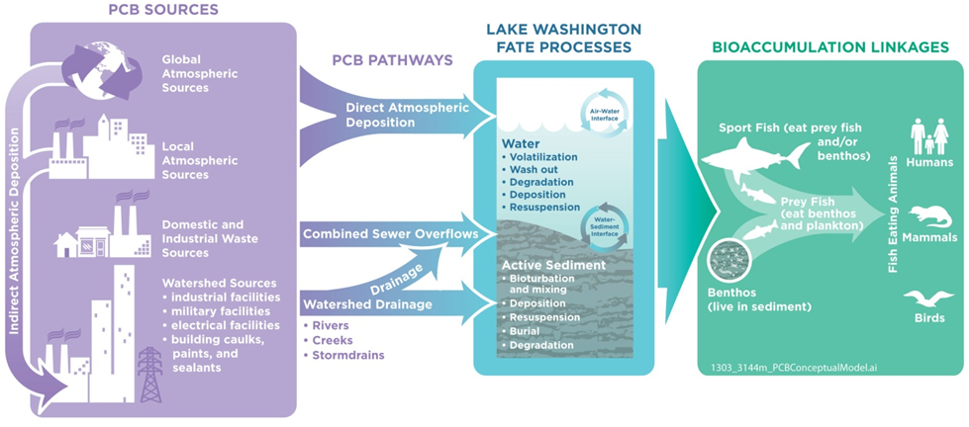
Conceptual Model for PCBs

Slide 3
Major Pathways
Rivers (Cedar and Sammamish)
Local Drainages
  Monitored tributaries
    Thornton Creek
    Juanita Creek
    May Creek
  Remaining unmonitored lake drainage
CSOs
Floating bridges (stormwater runoff)
Direct atmospheric deposition

Slide 4
Loadings Estimates
Concentration X Flow = Loading
Field study mean concentration used, except
Extrapolation approach for unmonitored tributaries
Enhanced CSO data with historical data
Flow
Gauged flow data OR
Estimated

Slide 5
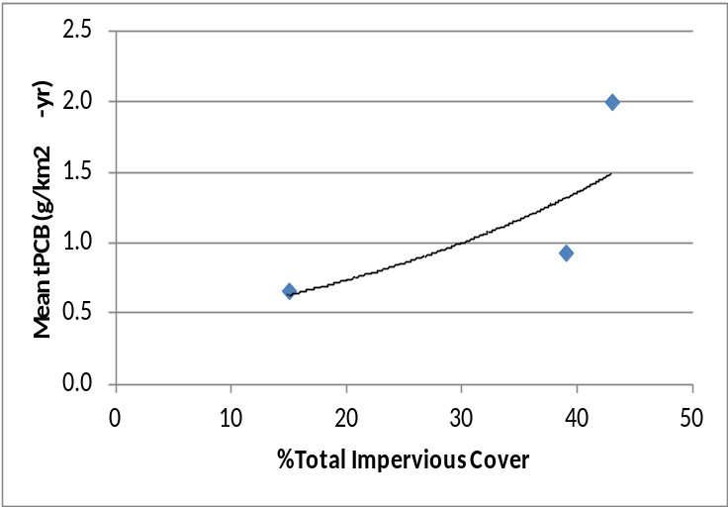
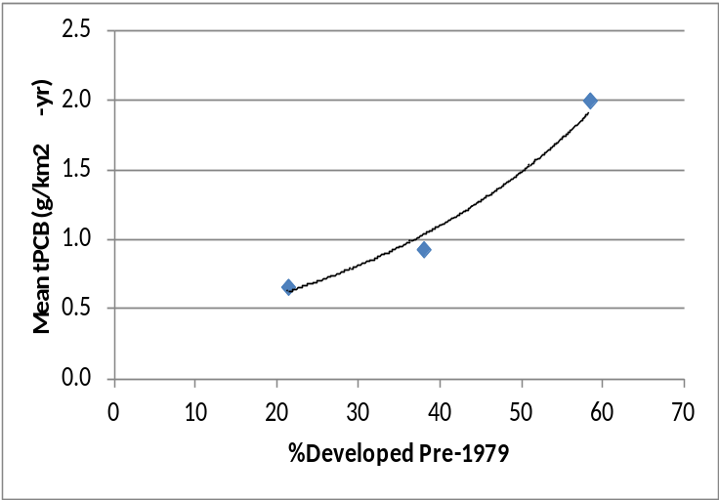
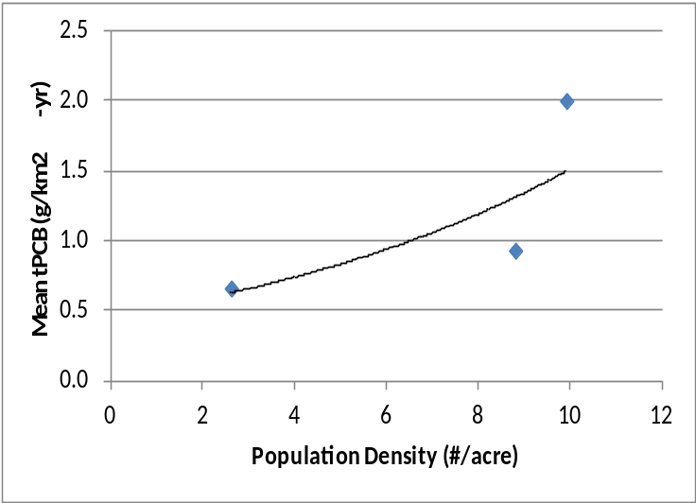
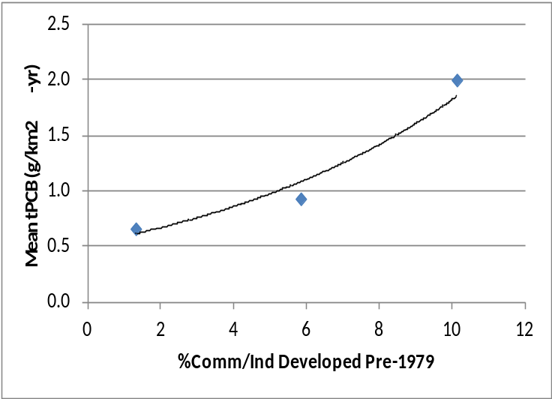
Correlations with Land Use/Population
tPCB (g/m²-yr)
tPCB (g/m²-yr)
%Total Impervious Cover
%Developed pre-1979
tPCB (g/m²-yr)
tPCB (g/m²-yr)
Population Density (#/ac)
%Commercial/Industrial Dev pre-1979
Notes:
1979 cutoff selected b/c final federal ban on PCBs
Label tributary dots

Slide 6
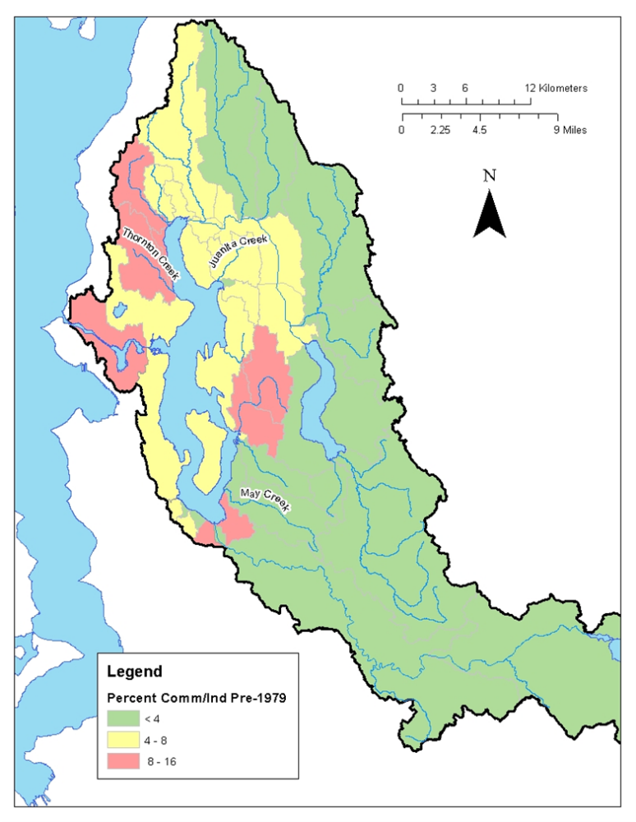
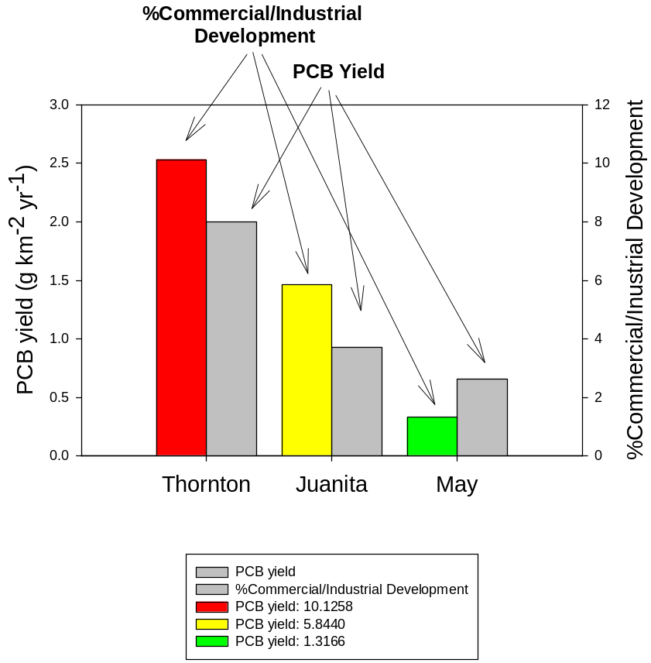
Relationship with Historical LandUse?
Notes:
1979 cutoff selected b/c final federal ban on PCBs
Label tributary dots

Slide 7
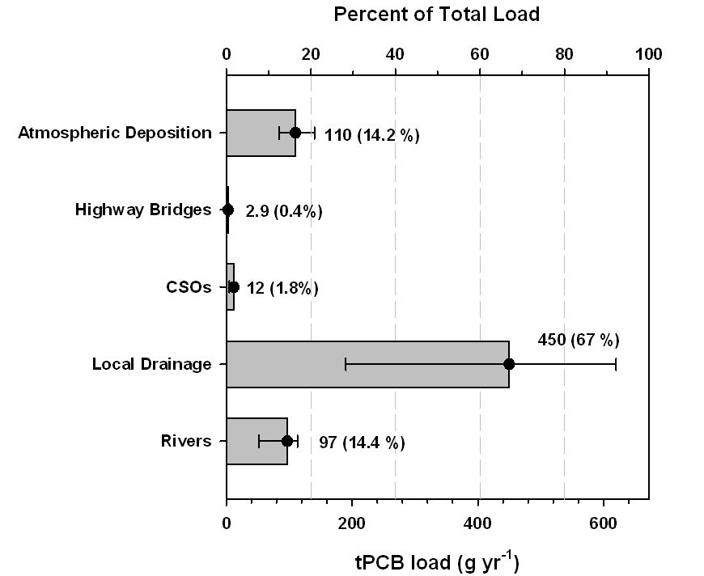
Current PCB
Loading Estimates
672 g yr⁻¹ to Lake Washington
140 g yr⁻¹ exits Lake Washington
360 g yr⁻¹ to Puget Sound

Slide 8
PCB Loading Summary
Bridges 3 g
CSOs 12 g
Rivers 97 g
Local Dr. 450 g
110 g
4.8 g
?
140 g
360 g
Puget
Sound
672 g
Bridges 1 g
CSOs 58 g
Local Dr. 40 g
Lake Union/Ship Canal
Lake Washington
562 g + 110 g = 672 g
672 g – 140 g = 532 g

Slide 9
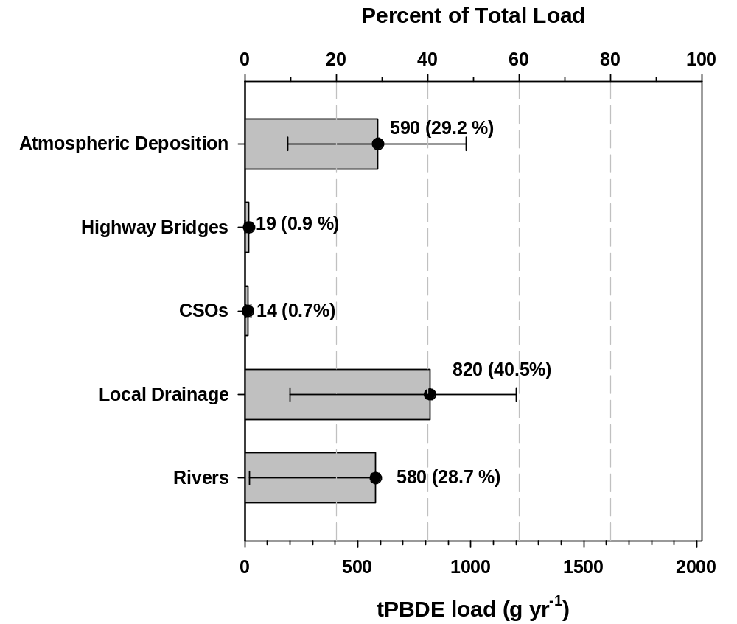
Current PBDE
Loading Estimates
2,023 g yr⁻¹ to Lake Washington
968 g yr⁻¹ exits Lake Washington
990 g yr⁻¹ to Puget Sound

Slide 10
PBDE Loading Summary
Bridges 19 g
CSOs 14 g
Rivers 580 g
Local Dr. 820 g
590 g
25 g
?
800 g
990 g
Puget
Sound
2,023 g
Bridges 5.6 g
CSOs 68 g
Local Dr. 69 g
Lake Union/Ship Canal
Lake Washington
1,433 g + 590 g = 2,023 g
2,023 g – 800 g = 1,223 g

Slide 11
Load from Local Drainage Driven by Stormwater
Stormwater is <30% of annual flow in streams BUT
Accounts for 80-90% of annual PCB load from local drainage

Slide 12
Loadings Conclusions
Appears to be relationship between local tributary PCB areal loading and age and/or type of development
As much as 70% of lake PCB load comes from local tributaries
As much as 80% of local tributary PCB load delivered in stormwater
Lake Washington is a sink for PCB and PBDE

Slide 13

QUESTIONS?
Search: lake washington pcb study
http://www.kingcounty.gov/environment/watersheds/cedar-river-lake-wa/pcb-pbde-loadings.aspx

